Slide 1
Energy efficient data transmission in automatic irrigation system using wireless sensor networks
Nesa Sudha, M., Valarmathi, M., & Babu, A. S. (2011). “Energy efficient data transmission in automatic irrigation system using wireless sensor networks”. Computers and Electronics in Agriculture, 78, 215–221.
Medini J. Aradhya, Anushka Swarup

Slide 2
Automatic Irrigation Systems
Automatic irrigation is done by making use of highly accurate sensors.
Help farmers by eliminating cost of labor for watering and fertilizing.
A single farmer can manage more than one field.

Slide 3
Introduction
Automatic irrigation done with the help of:
two sensors
solenoid valves
a pump.
Sensor data is interpreted by microcontroller which then activates the motor according to the need of the soil.

Slide 4
Objective
To provide an energy efficient algorithm for the wireless sensor communication used in an automated irrigation system.
Achieved using:
Time Division Multiple Access (TDMA)
Data Aggregation

Slide 5
Wireless Sensor Networks
Devices which contain a number of wireless sensor nodes.
Each node has one or more sensors, embedded processors and low power radios which are battery operated.
WSNs have loss links that are greatly affected by environmental factors
The radio part in a sensor node consumes more energy.

Slide 6
MAC Layer
MAC protocols play a vital role in the energy saving process of a WSN.
Scheduling based schemes like TDMA which determines the network connectivity first and design collision-free links to each node.
Except for the transmission and sensing durations, nodes can be put to sleep and highest amount of power savings possible.

Slide 7
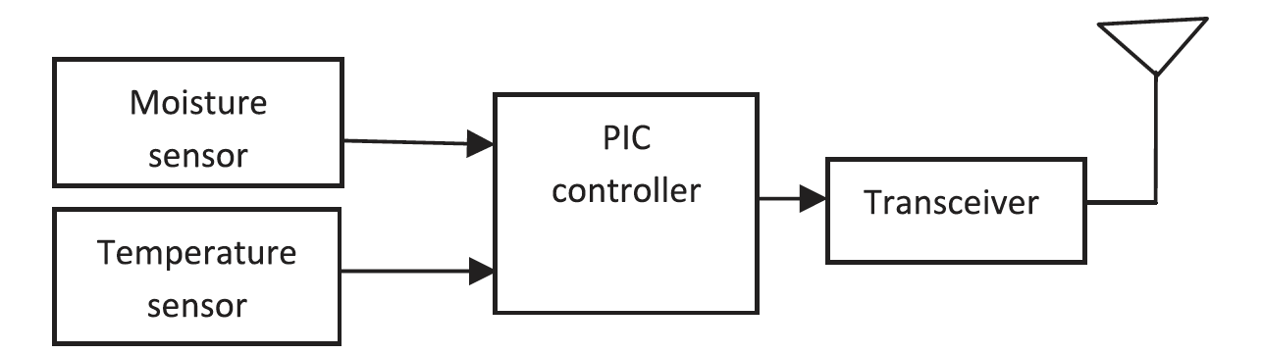
Sensor Node
Each node consists of:
A moisture sensor to warn of plant stress and optimize irrigation.
The VG400 series soil moisture sensor probes from Vegetronix were used
A temperature sensor to measure the temperature of plant.
A C program corrects and formats sensor values and then output the results to the onboard transceiver.

Slide 8
20 bytes data:
4 bytes for temperature
5 bytes for moisture level
The remaining 11 bytes were reserved for future use.
Most of the time the sensor node was in the receive mode.
The sensing of environment and data transmission occurred whenever it was requested by the base station.

Slide 9
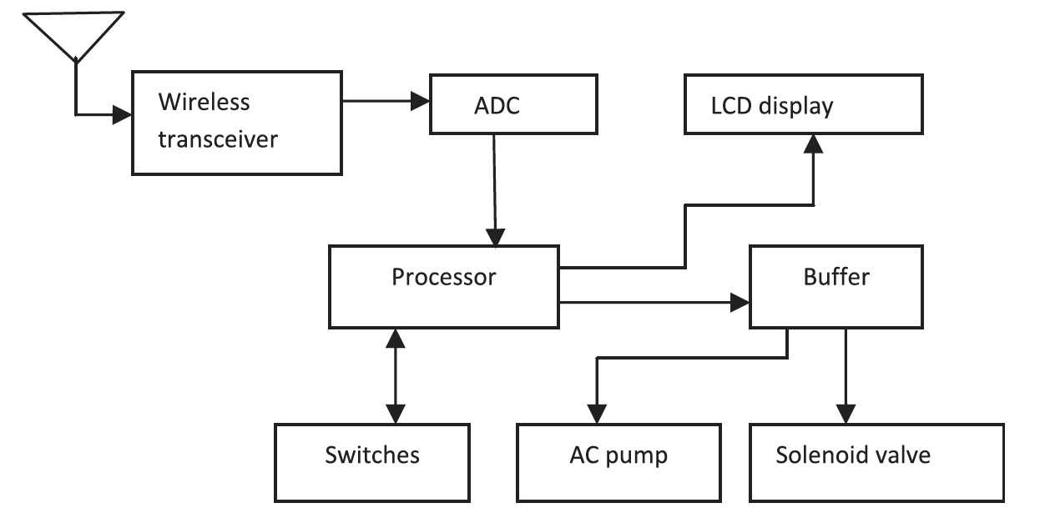
Base station
The base station consists of a transceiver, processor, and LCD display.
On receiving data from sensor nodes, the base station compared this value with a threshold value.
If the measured value was less than the required value, the controller did the necessary actions.

Slide 10
Direct Communication
System consists of a base station and sensor nodes.
Base station assigned each node with a unique address.
When the base station required data from an area it broadcast the address of that sensor node.
All the nodes received this address but only the addressed node responded with the data.
After sending the required data the node went back to the idle state. This process was repeated for all the nodes.
Notes:
Each sensor node will measure the temperature and the moisture level of the soil.
Each sensor node was equipped with a power amplifier PA2460 and had a range of 1 km.

Slide 11
Data Aggregation
Plays a major role in reducing the energy consumption by the sensors.
Data Accumulation – the header node collected the data from all the nodes and just bypassed them to the base station without altering the data.
Data Aggregation - the header node collected the data from all the nodes and aggregated them depending on different techniques.

Slide 12
Communication Overview
All the sensor nodes were grouped into three clusters;
each contained six nodes and a cluster head.
Single hop Communication with two stages:
Communication between base station and cluster heads.
Communication between cluster heads and the cluster members.
Notes:
Both communication stages employ the us of TDMA technology

Slide 13
Communication Overview
Basic system consists of a base station and sensor nodes.
Each sensor node measures temperature and moisture level of soil.
Initially all nodes are in idle/receive only mode.
When base station needs data from a certain node it broadcasts address of the cluster head of the cluster in which the node is present.
The cluster head collects data from all nodes in that cluster based on a TDMA schedule
The collected data is aggregated and then sent to the Base Station.
Notes:
Sensor nodes equipped with a power amplifier and had a range of 0.6miles.
All the sensor nodes are assigned a unique address which is known to the base station

Slide 14
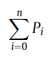
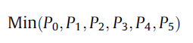
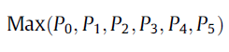
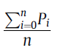
Data aggregation methods :
Sum.
Minimum.
Maximum.
Averaging.
‘i’ - node number ‘n’ - maximum number of nodes
‘Pi’ - Data present in each node at that instant.
Notes:
There are other Medical Imaging Techniques like
MRI – Magnetic Resonance Imaging
CT – Computed Tomography
PET – Positron Emission Tomography. Etc
But UBM in this implementation is : A) Fast B) Reconfigurable C) able to delineate small structures with final Spatial Resolution.
Used for Ophthalmology, Dermatology, malignant tumor diagnosis, cardiac diseases ( non invasive diagnosis ) and Embryonic developmental biology.

Slide 15
Sum
Header node collects data and gives the added value to the base station.
Major drawback : No way for base station to determine how many nodes provided the data. ( Hence, can’t determine how many nodes failed during transmission)
Minimum
Header node collects the data and determines the data with minimum value.
Major drawback : The node farthest away from source will always produce a minimum value.
Hence, difficult to estimate the exact temperature distribution in the area.

Slide 16
Maximum
Header node collects the data and determines the data with maximum value.
Major drawback : The node closest to the source will always produce max value , making it difficult to estimate exact temperature distribution in the area.
Average
Header node collects the data and determines the data of minimum value.
Major advantage : Base station is able to estimate the exact number of nodes and the number of nodes that failed during transmission
It helps in better estimation of temperature distribution over that area.

Slide 17
Comparing the two methods :
Direct Communication:
Header node collected all the readings from the nodes.
It then transmitted all the data individually to the base station
As a result a lot of energy was consumed
Energy consumption was more in this approach.
Data Aggregation:
Header node collected all the readings from the nodes and aggregated them using averaging technique.
But the header node transmitted only one data instead of transmitting all the data.
As a result energy was saved.

Slide 18
Results
Network simulator-2(NS-2) (www.isi.edu/nsnam/ns/) has been used for the analysis of both the algorithms.
The matrices used for the performance analysis are average energy and the throughput of the network.

Slide 19
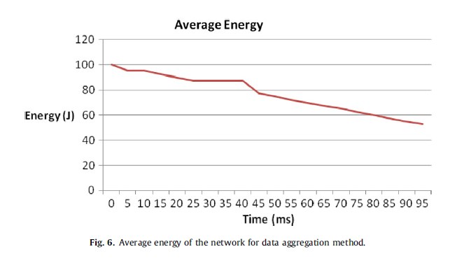
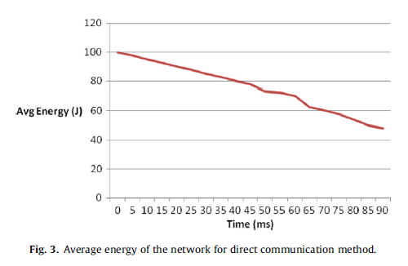
Results
Avg. Energy V/s Time:
Energy decreased as a function of time.
Final energy reached up to 48 J for Direct Communication method
Final energy reached up to 58 J for Data Aggregation method

Slide 20
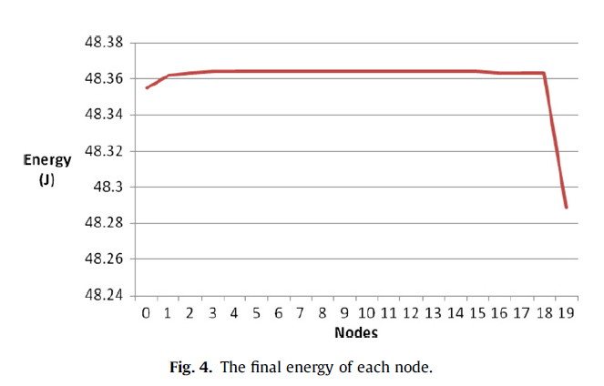
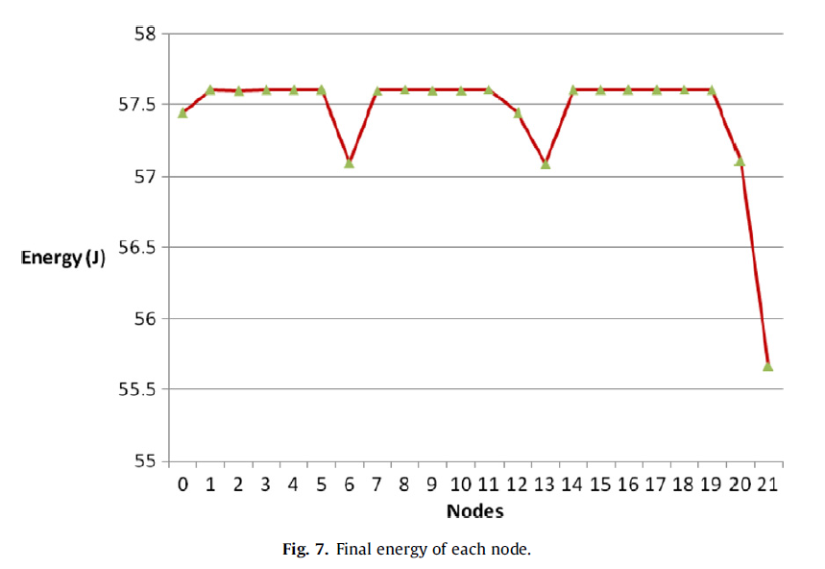
Results
Energy V/s Nodes:
Avg. Energy at the nodes are higher for Data Aggregation method.
Multiple dips in the graph corresponds to the cluster heads (data agg. method)

Slide 21
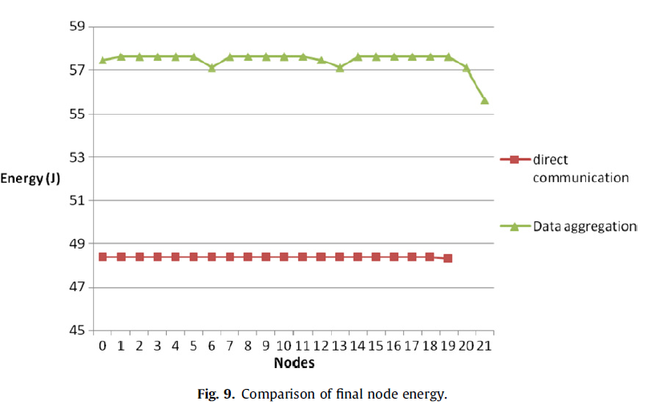
Results
Energy V/s Nodes:

Slide 22
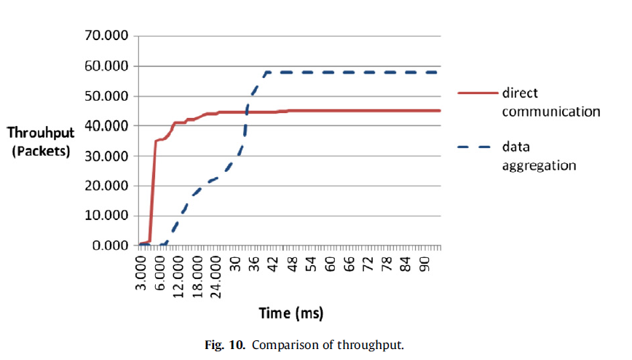
Results
Graph shows that the throughput of the network also had increased by a considerable value.
Increased from the 45*1000 packets to 58*1000 packets from direct communication method to data aggregation method.

Slide 23
Conclusion and Drawbacks
Conclusion : The main objective of the aggregation method was to reduce the energy consumption and to increase the network throughput which was observed by the simulation results.
Drawbacks : → Since it was not physically implemented, other environmental factors could lead to performance issues or transmission losses. (not considered while simulation) → Cluster Heads are determined by energy of the nodes of the cluster after each TDMA cycle. But the node closest to the source amongst the cluster would always be the cluster head.

Slide 24
Future Scope
To implement this in real time and determine the external parameters that should also be taken into account.
Ways to minimize the energy loss while transmission.

